Slide 1
Recap of Class 3
Introducing the Bureaucracy
Why Congress may prefer agencies to courts as sources of legal implementation
History of agencies and executive branch growth spurts
“Discretion” and its control as the central preoccupation of administrative law
Likelihood of tension among important values
Introducing Statutory Construction
Discussed role of “pragmatic enrichment” in understanding the meaning of commands
Noted distinction between interpretation and construction
Defined and contrasted intentionalism, purposivism, and textualism – also noted overlapping concern for legislative supremacy

Slide 2
Contrasting Premises
Purposivist
  Congress acts rationally to achieve its purposes
  Laws should be read in light of their purposes because legislatures may act in haste or inattentively
Textualist
  Every statute is a compromise
  Misalignments between purpose and detail likely to reflect bargains
  Fidelity to Congress = fidelity to the bargain, especially because “purpose” too slippery a guide to interpretation (statutes serve multiple purposes)

Slide 3
Katzmann on Legislative History
Legislators give it weight
Members more likely to rely on history than read text of bills
Committees are representative of the larger body
Dictionaries not often used by pro drafters
Creators of legislative history value credibility
Drafters pay little attention to canons

Slide 4
Two Gun Regulation Cases
Is a semiautomatic rifle equipped with a bump stock a “machine gun?”
Is a kit for assembling a gun a “firearm?”
Without reading the statutes, if you were told the answer to one of these questions was “yes,” which one would you guess?

Slide 5
Garland v. Cargill (2024)
What is the issue?
Does a bump stock—an accessory for a semiautomatic rifle that allows the shooter to rapidly reengage the trigger (and therefore achieve a high rate of fire)—convert the rifle into a “machinegun?”
Why does it matter?
  The GCA of 1968 makes it unlawful for any person to transfer or possess a machinegun unless it was lawfully possessed prior to the effective date of the statute.

Slide 6
Lower Court Proceedings
Bump stock owner loses in the District Court
Court of Appeals first affirms, then reverses en banc
  Majority: If statute is ambiguous, “rule of lenity” means the bump stock owner wins
  Plurality: Bump stocks don’t fit the statutory definition

Slide 7
26 U.S.C. § 5845
(b)Machinegun. The term “machinegun” means any weapon which shoots, is designed to shoot, or can be readily restored to shoot, automatically more than one shot, without manual reloading, by a single function of the trigger. The term shall also include the frame or receiver of any such weapon, any part designed and intended solely and exclusively, or combination of parts designed and intended, for use in converting a weapon into a machinegun, and any combination of parts from which a machinegun can be assembled if such parts are in the possession or under the control of a person.

Slide 8
The Role of the Agency
ATF issued a rule defining machineguns to include bumpstocks: “[T]he term ‘automatically’ as it modifies ‘shoots, is designed to shoot, or can be readily restored to shoot,’ means functioning as the result of a self-acting or self-regulating mechanism that allows the firing of multiple rounds through a single function of the trigger; and ‘single function of the trigger’ means a single pull of the trigger and analogous motions. The term ‘machinegun’ includes a bump-stock-type device, i.e., a device that allows a semi-automatic firearm to shoot more than one shot with a single pull of the trigger by harnessing the recoil energy of the semi-automatic firearm to which it is affixed so that the trigger resets and continues firing without additional physical manipulation of the trigger by the shooter.”

Slide 9
ATF’s Interpretation
Interprets “single function of the trigger” to mean “a single pull of the trigger and analogous motions.”
A shooter using a bump stock, it asserts, must pull the trigger only one time to initiate a bump-firing sequence of multiple shots.
This initial trigger pull sets off a sequence—fire, recoil, bump, fire—that allows the weapon to continue firing “without additional physical manipulation of the trigger by the shooter.”
All the shooter must do is keep their trigger finger stationary on the bump stock's ledge and maintain constant forward pressure on the front grip to continue firing.

Slide 10
Why majority overturns?
A semiautomatic rifle equipped with a bump stock does not fire more than one shot “by a single function of the trigger.”
  Uses dictionary definitions of “function” and “trigger” (IIA)
A semiautomatic rifle without a bump stock could be a machinegun under the same theory.
  A semiautomatic rifle with a bump stock is indistinguishable from another weapon that ATF concedes cannot fire multiple shots “automatically”: the Ithaca Model 37 shotgun.
Even if a semiautomatic rifle with a bump stock could fire more than one shot “by a single function of the trigger,” it would not do so “automatically.”
  Requires precise amount of forward pressure on the rifle’s front grip

Slide 11
Reasons for Dissenting
A shooter using a bump stock must pull the trigger only one time to initiate a bump-firing sequence of multiple shots.
Because the trigger's internal mechanism must reset each time a weapon fires, the majority reads each reset as a new “function.” That reading fixates on a firearm's internal mechanics while ignoring the human act on the trigger referenced by the statute.

Slide 12
Reasons for Dissenting - 2
Evidence of contemporaneous usage including congressional testimony of NRA president
“The majority cannot disregard these statements as evidence of legislative purpose. They are, along with contemporaneous dictionary definitions, some of the best evidence of contemporaneous understanding.”
“[T]here is no commonsense difference between a firearm where a shooter must hold down a trigger or flip a switch to initiate rapid fire and one where a shooter must push on the front grip or barrel to do the same.”
“[T]he best way to respect congressional intent is to adhere to the ordinary understanding of the terms Congress uses.”

Slide 13
Presumption Against Ineffectiveness
“This Court has repeatedly avoided interpretations of a statute that would facilitate its ready ‘evasion’ or ‘enable offenders to elude its provisions in the most easy manner.’”
“The presumption against ineffectiveness ensures that a text's manifest purpose is furthered, not hindered.”

Slide 14
Note: No Deference to ATF
Possible reason for deference: Agency expertise
Public reaction after a gunman fired on a crowd attending an outdoor music festival in Las Vegas, killing 58 people and wounding over 500 more in October 2017
Possible reason not to defer: Agency changed its stance
  On more than 10 separate occasions over several administrations, ATF consistently concluded that rifles equipped with bump stocks cannot “automatically” fire more than one shot “by a single function of the trigger.”

Slide 15
Bondi v. Vanderstok (2025)
28 U.S.C. § 921(a)
(3)The term “firearm” means (A) any weapon (including a starter gun) which will or is designed to or may readily be converted to expel a projectile by the action of an explosive; (B) the frame or receiver of any such weapon; (C) any firearm muffler or firearm silencer; or (D) any destructive device. Such term does not include an antique firearm.

Slide 16
What’s are the Issues?
Whether certain firearms kits = “firearms” under the definition
  If so, the guns assembled through the kits must have serial numbers
District Court and the Court of Appeals both decided for the gun manufacturers who brought a facial challenge to the ATF rule

Slide 17
Agency Rule Elaborates on the Statutory Definition
ATF Rules: Any weapon, including a starter gun, which will or is designed to or may readily be converted to expel a projectile by the action of an explosive; the frame or receiver of any such weapon; any firearm muffler or firearm silencer; or any destructive device; but the term shall not include an antique firearm. In the case of a licensed collector, the term shall mean only curios and relics. The term shall include a weapon parts kit that is designed to or may readily be completed, assembled, restored, or otherwise converted to expel a projectile by the action of an explosive. The term shall not include a weapon, including a weapon parts kit, in which the frame or receiver of such weapon is destroyed as described in the definition "frame or receiver."

Slide 18
Why did ATF decide to cover kits?
These mandates serve at least two ends. The background-check requirement seeks to keep “guns out of the hands of criminals.” The licensing, recordkeeping, and serialization requirements, meanwhile, aim “to assist law enforcement authorities in investigating serious crimes,” by permitting them “to determine where, by whom, or when” a firearm was manufactured and to whom it was “sold or otherwise transferred.”
Recent years . . . have witnessed profound changes in how guns are made and sold.

Slide 19
Why majority upholds?
The term “weapon” is an artifact noun—a word for a thing created by humans. Artifact nouns are typically “characterized by an intended function,” rather than by “some ineffable ‘natural essence.’ ” S. Grimm & B. Levin, Artifact Nouns: Reference and Countability, in 2 Proceedings of the 47th Annual Meeting of the North East Linguistic Society (NELS 47) 55 (2017)

Slide 20
Why majority upholds? - 2
Firearms: [A]s a matter of everyday speech, [a] rifle is a weapon, whether disassembled or combat ready. In the same way and for the same reason, an ordinary speaker might well describe the “Buy Build Shoot” kit as a “weapon.”
Analogy to starter guns
  Not a “weapon” until converted
  Many kits no harder than starter guns to convert into weapons

Slide 21
Gun Control Act v.
National Firearms Act
“A statute's text and context are critical to determining whether (and to what extent) Congress used an artifact noun to reach unfinished objects. And, without doubt, the NFA and the GCA are different statutes passed at different times to address different problems using different language. Our analysis of the GCA thus does not begin to suggest that ATF possesses authority to regulate AR–15 receivers as machineguns under the NFA.” [Not in excerpt]

Slide 22
Role of Statutory Canons
Neither lenity nor avoidance has any role to play where “text, context, and structure” decide the case.
  Rule of lenity
  Constitutional avoidance canon

Slide 23
Dissenting Argument - Thomas
The majority proceeds under the faulty premise that our standard rules of statutory interpretation do not apply to “a word for a thing created by humans.”
Omitted from the excerpt:
Other statutes address collections of parts specifically
“Firearms,” as used in other statutes, could not reasonably include kits
GCA mentions only certain parts explicitly
Statutory definition of “frame” does not mention conversion

Slide 24
Some Persistent Puzzles
Should judges apply statutes according to their “letter” or “their spirit?”
  What is “spirit?”
    The legislators’ subjective or imputed intentions
    The “objective” purpose of the statute
    Public policy as identified by the judges
      Based in common law?
      Based on social values?
Big puzzles
  Is there ever evidence of intentions or purpose more compelling than the text? How then to explain that Congress historically overrules more textualist interpretations than purposive interpretations?
  What does it mean to hew to the text when, in case after case, judges who purport to agree on method disagree on meaning?

Slide 25
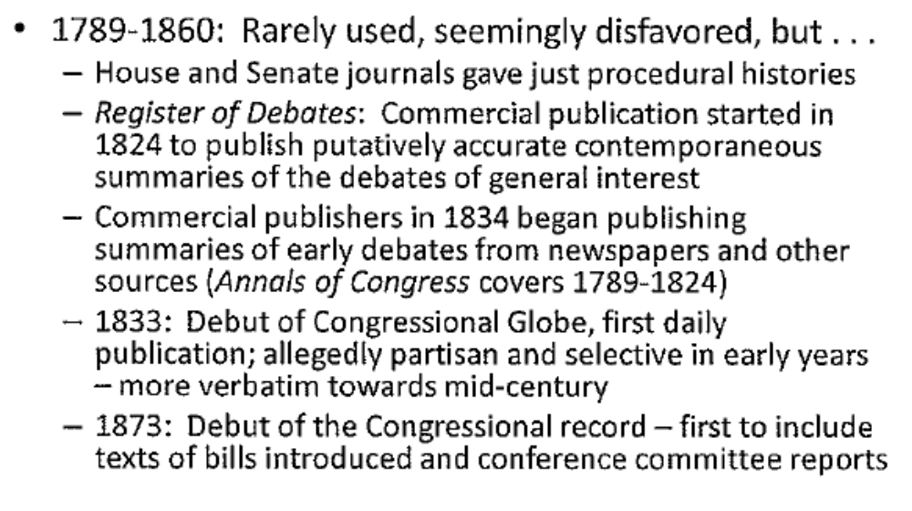
Trends in Use of Legislative History

Slide 26
History of Legislative History
1860-1940: Increasing, but still sporadic use
1940s to mid-1980s: Heyday of legislative history use
  Manning and Stephenson suggestions:
    Statutes more plentiful and open-ended
    Different conceptions of judicial role? (Partnership in lawmaking?)
  Other possibilities
    Improved quality of histories
    Access gave DOJ an advocacy advantage
1980s-Present: A resurgence of textualism

Slide 27
Priority of Legislative History Sources
Conference committee reports
One-house committee reports
Statements by legislative sponsors
Changes in multiple versions of a bill; rejected proposals
Statements by legislators in floor debate
Statements during hearings
Legislative silence – dogs that don’t bark
Post-enactment activity

Slide 28
Legislative History
Potential uses
  To discern how a word was being used?
  To ascertain intent on a specific issue?
  To ascertain purpose – e.g., by discerning the problem that motivated the legislation?
Questions
  Are all of these equally appropriate/ inappropriate?
  How to weigh different sources?

Slide 29
Train v. CPIRG (1976)
Federal Water Pollution Control Act authorizes "citizen suits" against the Administrator of EPA for failure to perform nondiscretionary duties under the FWPCA
Respondents are Colorado-based organizations and Colorado residents
Claim potential harm from the discharge of radioactive effluents from two nuclear plants operated under radioactive effluent standards imposed by the Atomic Energy Commission (now the Nuclear Regulatory Commission) pursuant to the Atomic Energy Act
EPA won’t issue standards of its own to govern the discharge of any radioactive materials subject to regulation under the AEA
CPIRG argues that the definition of a "pollutant" under the FWPCA encompasses all radioactive materials, including those regulated under the terms of the AEA

Slide 30
What AEA Covers
“The term ‘source material’ means (1) uranium, thorium, or any other material which is determined by the Commission pursuant to the provisions of section 2091 of this title to be source material; or (2) ores containing one or more of the foregoing materials, in such concentration as the Commission may by regulation determine from time to time.” 42 U.S.C. s 2014(z).
“The term ‘special nuclear material’ means (1) plutonium, uranium enriched in the isotope 233 or in the isotope 235, and any other material which the Commission, pursuant to the provisions of section 2071 of this title, determines to be special nuclear material, but does not include source material; or (2) any material artificially enriched by any of the foregoing, but does not include source material.” 42 U.S.C. s 2014(aa).
“The term ‘byproduct material’ means any radioactive material (except special nuclear material) yielded in or made radioactive by exposure to the radiation incident to the process of producing or utilizing special nuclear material.” 42 U.S.C. s 2014(e).

Slide 31
The FWCPA Text
13 U.S.C. § 1362(6): The term “pollutant” means dredged spoil, solid waste, incinerator residue, sewage, garbage, sewage sludge, munitions, chemical wastes, biological materials, radioactive materials, heat, wrecked or discarded equipment, rock, sand, cellar dirt and industrial, municipal, and agricultural waste discharged into water

Slide 32
What difference does it make who regulates??
AEC: Requires licensees to “make every reasonable effort to maintain . . .releases of radioactive materials in effluents . . . as low as is reasonably achievable” 10 C.F.R. § 50.34(a)
Under FWPCA, effluent discharge requires a permit and permits require polluters to use the “best practicable control technology currently available” by 7/1/77 and “best available control technology economically achievable” by 7/1/83 33 U.S.C. § 1311(b).

Slide 33
Evidence Used from Legislative History
House Committee Report gives limited reading to the definition of pollutant even though nothing in the text modifies “radioactive materials”
Senate floor discussion between primary sponsor of FWPCA and Chairman of Joint Committee on Atomic Energy
House defeated amendment that would have allowed states to regulate radioactive discharges
Conference Committee report doesn’t challenge limited reading
Floor statement by member of the Conference Committee echoes Pastore-Muskie colloquy

Slide 34
Any Other Evidence (Context)?
Structure of regulatory programs very different because FWCPA envisions state involvement
Difference between regulating nuclear power industry as such and regulating radioactive materials from other economic activities

